Slide 1
Video Plus Depth Compression for Mobile 3D Service
By: Abir Ahmed, Dumkene Izuora, Ferhan Jamal,Tobi Ajila and Vincent Chukwuekezie

Slide 2
Outline
Introduction
Mpeg-C part 3
H.264 Auxiliary Picture Syntax
Experimental Results
Summary

Slide 3
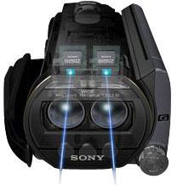
Introduction
How 3D Works
Captured using a camera with two lenses
http://static.bhphotovideo.com/explora/explora/sites/default/files/Main-3D-Camera.jpg

Slide 4
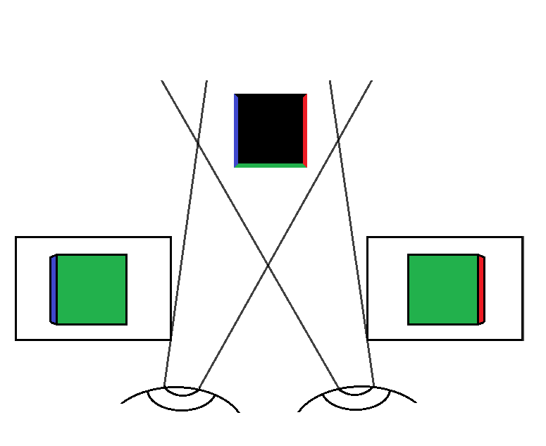
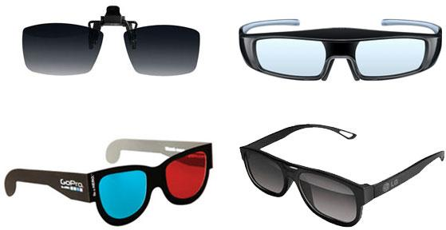
3D Viewing
Image for each eye
http://static.bhphotovideo.com/explora/explora/sites/default/files/3D-glasses-collage-1.jpg

Slide 5
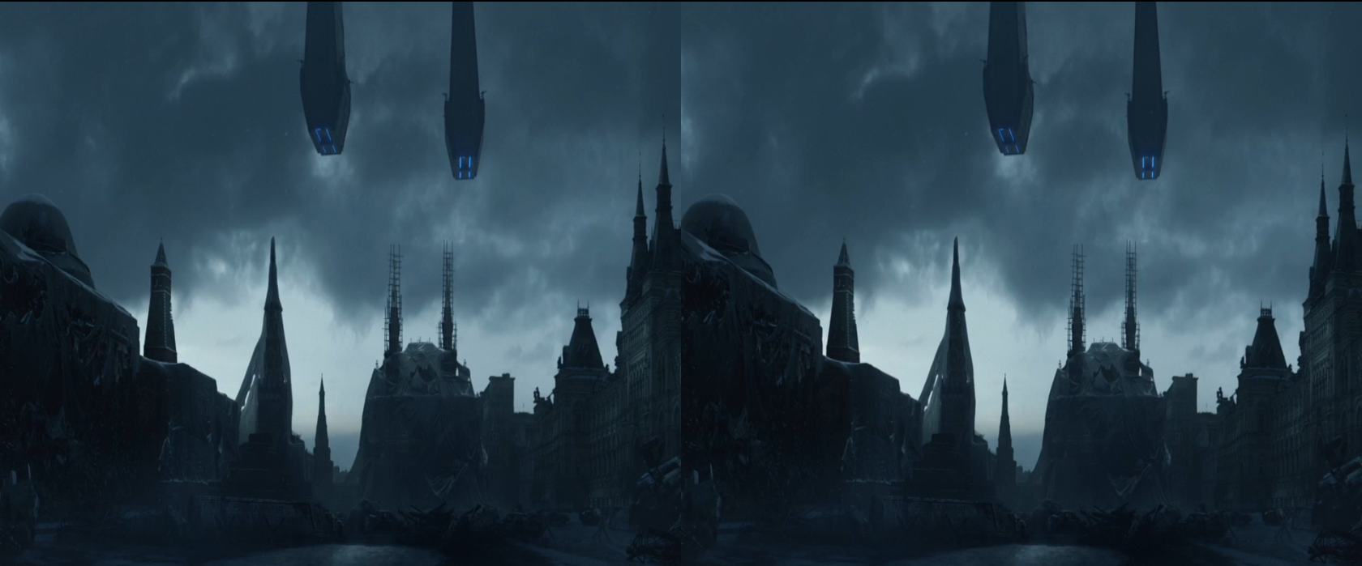
3D Encoding
https://www.youtube.com/watch?v=6acRHWnfZAE

Slide 6
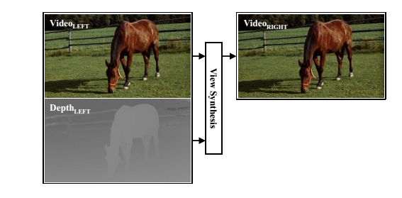
3D Using Depth Data

Slide 7
Advantage / Disadvantage for Depth Based 3D
Less redundant information
Better Compression
Lower bitrate
More process intensive on decoding end
Distorted reproduction
Increased complexity

Slide 8
MPEG-C Part 3
MPEG coding standard for video plus depth coding
Representation format for Depth Maps
Also known as ISO/IEC 23002-3 standard
This standard does not specify transport and compression techniques

Slide 9
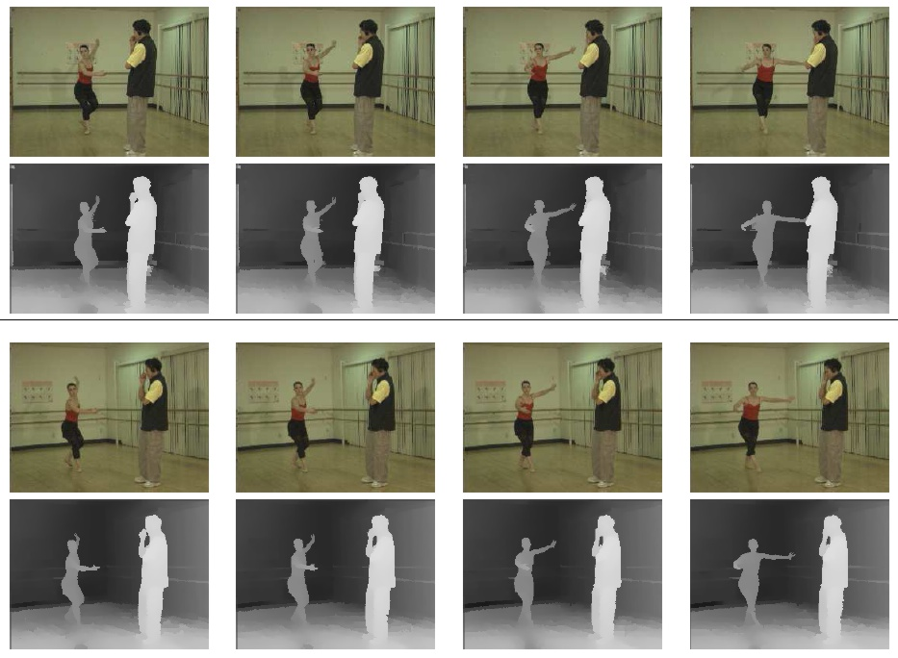
Video Plus Depth Coding (MPEG-C Part 3)
Video Plus Depth Coding

Slide 10
Features (MPEG-C Part 3)
Able to support both stereo and multi-view displays
Allows adjustment of depth perception in stereo displays
Adjustment can be done according to viewing characteristics
Adjustment can be display size and viewing distance

Slide 11

Use (MPEG-C Part 3)
MPEG-C Part 3 use is illustrated in this image :

Slide 12
Use (MPEG-C Part 3)…Cont’d
In the previous image, 2 encoders are producing 2 streams:
One for video and one for depth
2 streams are then multiplexed into single stream(TS)
At Receiving side, these streams are then de multiplexed and at receiver we have :
Output video and depth signals
2nd stereo view from above two streams

Slide 13
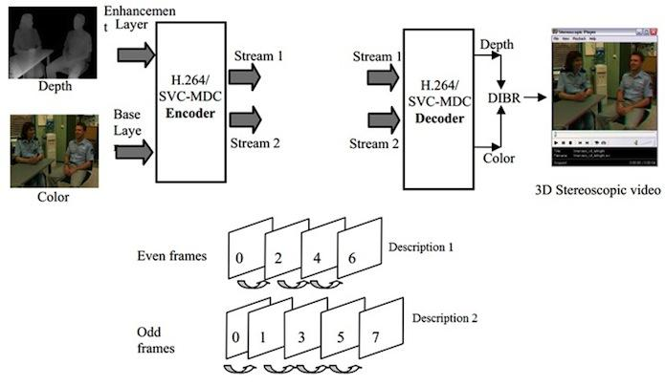
Use (MPEG-C Part 3)…Cont’d

Slide 14
Drawbacks (MPEG-C Part 3)
Capable of rendering limited depth range
Not specifically designed to handle occlusions
Stereo Signals are not easily accessible by this format
Receivers are required to generate stereo displays
Finally, its not accurate

Slide 15
H.264 Auxiliary Picture Syntax
Additional data can be encoded using the Auxiliary Picture Syntax
The data has the same restrictions as a monochrome coded picture
The data does not have to be specified by the H.264 standard
Notes:
H264 is one of the most common video compression format used to distrubute content. It is a block-oriented motion-compensation-based video compression standard. One of the new features added to the standard are Auxiliary pictures.
The H264 standard defines an Auxiliary Picture Syntax. This specification permits one to encode additional data in the display process.
An auxiliary coded picture has the same syntactic and semantic restrictions as a monochrome redundant coded picture, where a monochrome coded picture is a picture with only one shade.
An auxiliary coded picture An auxiliary coded picture must contain the same number of macroblocks as the primary coded picture.
where macro blocks is a processing unint in video/image compression defined as
a 16 x 16 block of luma sample with corresponding chroma samples of a picture that has three sample arrays.
or a 16 x 16 block of samples of monochrome picture
or a picture that is coded using three separate colour planes (eg. RGB)
The auxiliary picture can be any data as long as it meets the requirements
-----------------------------------------------------------
auxiliary coded picture: A picture that supplements the primary coded picture that may be used in combination with other data not specified by this Recommendation | International Standard in the display process. An auxiliary coded picture An auxiliary coded picture must contain the same number of macroblocks as the primary coded picture.
Rec. ITU-T H.264 (02/2014) 7
Auxiliary coded pictures have no normative effect on the decoding process. See also primary coded picture and redundant coded picture.
macroblock: A 16x16 block of luma samples and two corresponding blocks of chroma samples of a picture that has three sample arrays, or a 16x16 block of samples of a monochrome picture or a picture that is coded using three separate colour planes. The division of a slice or a macroblock pair into macroblocks is a partitioning.
luma: An adjective specifying that a sample array or single sample is representing the monochrome signal related to the primary colours. The symbol or subscript used for luma is Y or L.
NOTE – The term luma is used rather than the term luminance in order to avoid the implication of the use of linear light transfer characteristics that is often associated with the term luminance. The symbol L is sometimes used instead of the symbol Y to avoid confusion with the symbol y as used for vertical location.

Slide 16
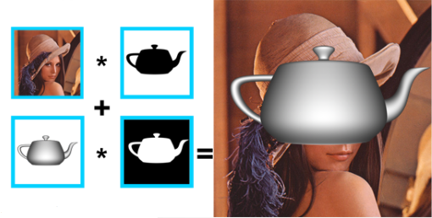
Auxiliary Picture examples
Alpha Compositing (alpha blend)
Notes:
Alpha compositioning
alpha compositing is the process of combining an image with a background to create the appearance of partial or full transparency.
consists of
image
alpha channel

Slide 17
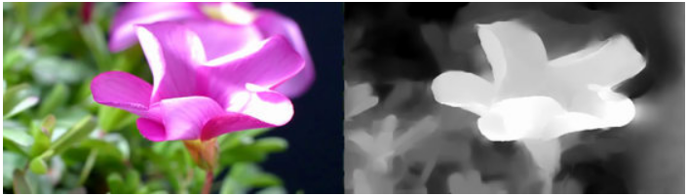
Video + Depth

Slide 18
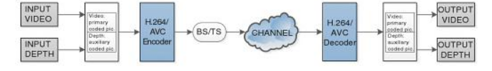
Auxiliary Picture Syntax

Slide 19
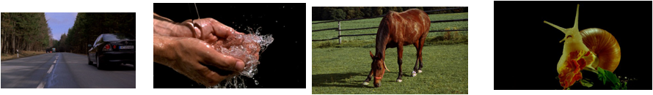
Experimental Results
The experiment was done using JM 14.2 implementation of H.264/MPEG-4 AVC codec.
The coding approaches were evaluated with 4 different videos and depth data sets that cover different types and levels of scene content complexity and temporal variation.

Slide 20
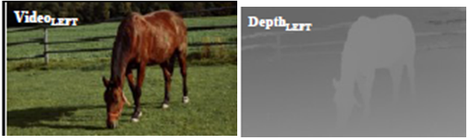
Experimental Results
The video and depth sequence are encoded and decoded independently.

Slide 21
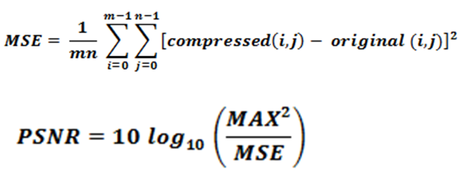
Experimental Results
To calculate the PSNR the original video was used as the reference to the compressed video.

Slide 22
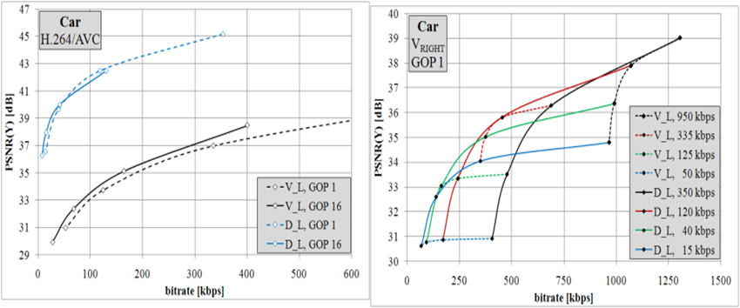
Original VS Compressed

Slide 23
Summary and Conclusion
V+D representation Format: Monoscopic color video and associated per sample depth image (depth map)
Video plus Depth coding for 3D Mobile application: MPEG-C Part 3 and H.264/AVC
Coding evaluation was based on the four sample V+D test data sets from different types and levels of scene content ,complexity and temporal variation

Slide 24
Summary and Conclusion Cont’l
Experimental result showed that the bitrate for acceptable quality depends on three (3) factors:
Properties of the Scene content
Quality of the depth map
View synthesis (temporal variation)
Higher gain (coding efficiency) was achieved with B-hierarchical picture (GOP 16) which lead to a significant reduction of bitrate (up to 50%)

Slide 25
Summary and Conclusion Cont’l
V+D appears to be best alternative for realisation of 3D video mobile services due to the following:
Adjustment of stereo rendering at the decoder side
Easy modification of 3D impression baseline
In conclusion, the experimental result has showed that a good depth quality can be achieved with the Video plus Depth approach at a lower bitrate.

Slide 26
References
Alpha blend
https://takinginitiative.wordpress.com/2010/04/09/directx-10-tutorial-6-transparency-and-alpha-blending/
Intelligent Multimedia Communication: Techniques and Applications
https://books.google.ca/books?id=Nxg_69gzdP0C&pg=PA58&dq=MPEG-C+Part+3&hl=en&sa=X&ei=nKkZVeTEGIGWNo6wgJAN&ved=0CDwQ6AEwBA#v=onepage&q=MPEG-C%20Part%203&f=false
3D Future Internet Media
https://books.google.ca/books?id=NOq3BAAAQBAJ&pg=PA27&dq=MPEG-C+Part+3&hl=en&sa=X&ei=nKkZVeTEGIGWNo6wgJAN&ved=0CDUQ6AEwAw#v=onepage&q=MPEG-C%20Part%203&f=false
All other sources are from the paper

